Slide 1
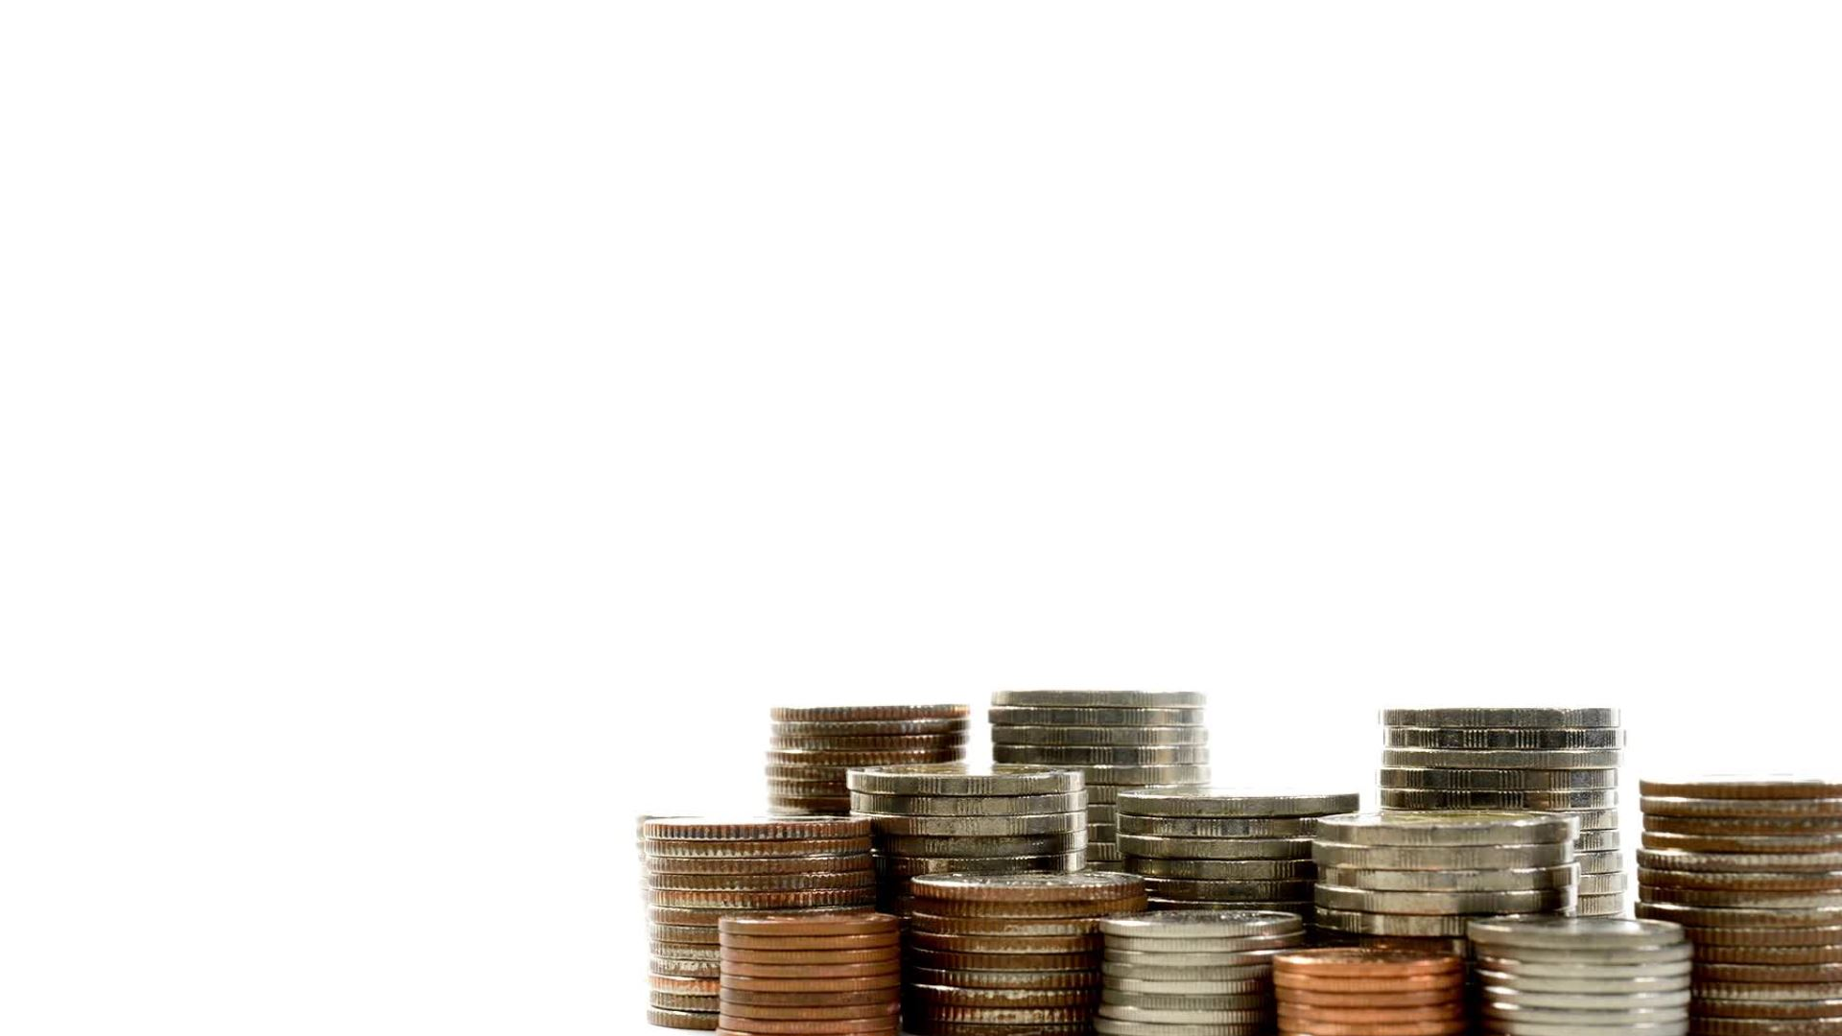
Metal Coin Classification Using Machine Learning
Analyzing and Classifying Coins Based on Impedance Measurements
Antonin Graf & Ghazraoui Zack

Slide 2
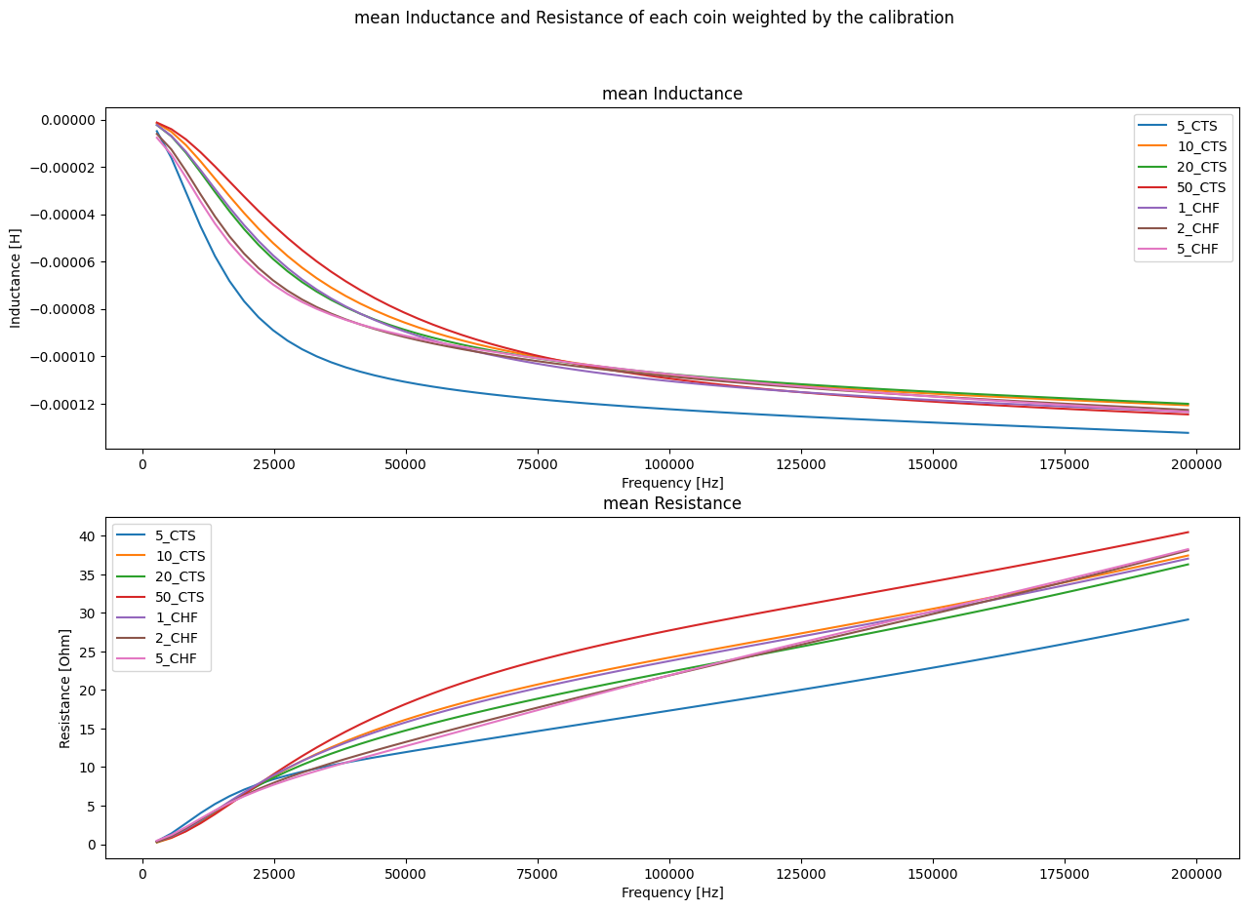
Data Collection
clean and preprocess the data -> Calibration

Slide 3
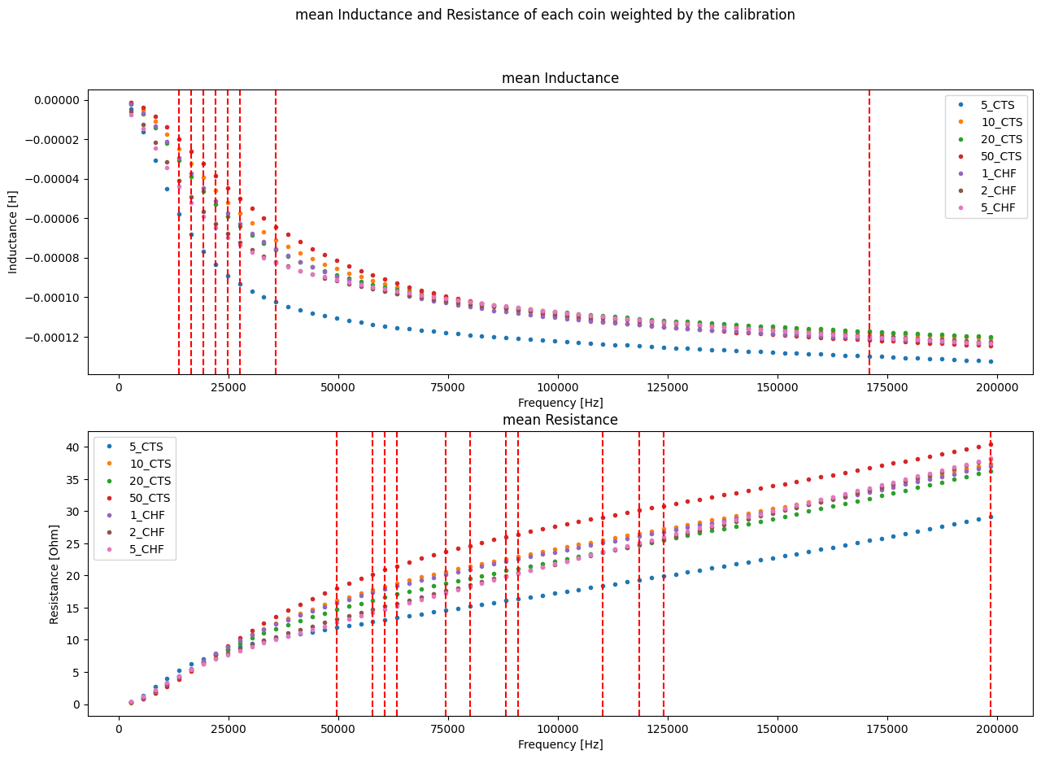
Choosing
The features
Custom algorithm for selecting the best frequencies
Adding features after first validation tests
-> Characteristic pole R/L

Slide 4

Choice of Model:
Selected the Support Vector Machine (SVM).
Effective for non-linear data.
Robust with limited datasets.
Why SVM:
Creates clear decision boundaries.
Handles complex data relationships well.
Ideal for coin classification tasks.
Alternatives Considered:
Logistic Regression: Less effective for non-linear data.
Decision tree : singular features needed
Neural Network : big training set

Slide 5
Training and Validation
Data Split
foreign
Train
Test
Valid
20 %
60 %
20 %
Training Set : Used to train the SVM model.
Validation Set : Used to tune and validate the model.
Test Set : Used to evaluate final model performance.

Slide 6
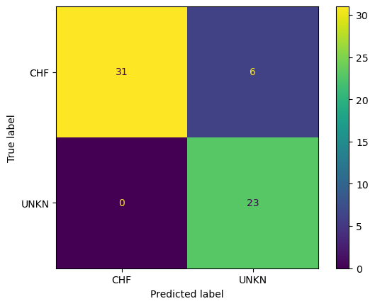
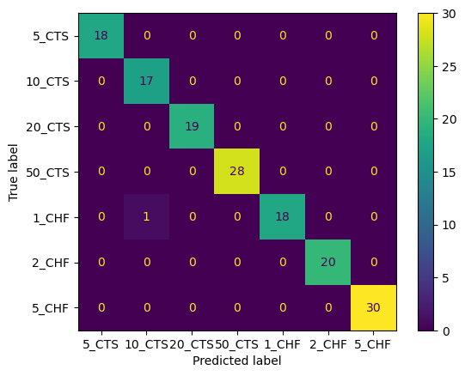
Training and Validation
Validation results
Unknown coin detection
Coin classification
Accuracy: 90%
Accuracy: 99.34%
False negative for best security
Error of classification between 1 CHF and 10ct CHF

Slide 7
Metrics
Results
Unknown coin detection :
Classification Report
 | Precision | Recall | F1 score | support
Unknown | 1.00 | 0.92 | 0.96 | 13
CHF | 0.96 | 1.00 | 0.98 | 27
Accuracy |  |  | 0.97 | 40
Macro avg | 0.98 | 0.96 | 0.97 | 40
Weighted avg | 0.98 | 0.97 | 0.97 | 40

Slide 8
Metrics
Results
Coin classification
Classification Report
 | Precision | Recall | F1 score | support
5 ct | 1.00 | 1.00 | 1.00 | 18
10ct | 0.95 | 0.91 | 0.93 | 22
20 ct | 1.00 | 1.00 | 1.00 | 22
50 ct | 1.00 | 1.00 | 1.00 | 25
1 chf | 0.91 | 0.95 | 0.93 | 22
2 chf | 0.91 | 0.95 | 0.93 | 22
5 chf | 0.95 | 0.90 | 0.93 | 21
Accuracy |  |  | 0.96 | 152
Macro avg | 0.96 | 0.96 | 0.96 | 152
Weighted avg | 0.96 | 0.96 | 0.96 | 152

Slide 9
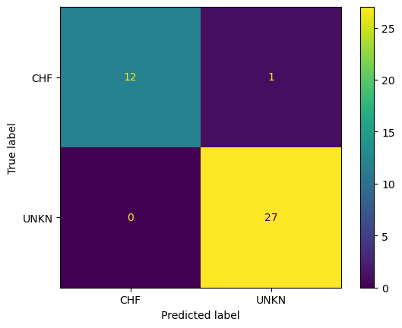
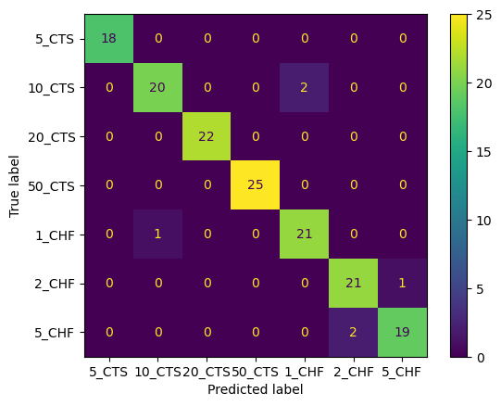
Results
Tests results
Unknown coin detection
Coin classification
Accuracy: 97.5%
Accuracy: 96%
False negative for best security
Error of classification between 1 CHF <->10ct CHF
And 2 CHF <-> 5 CHF

Slide 10
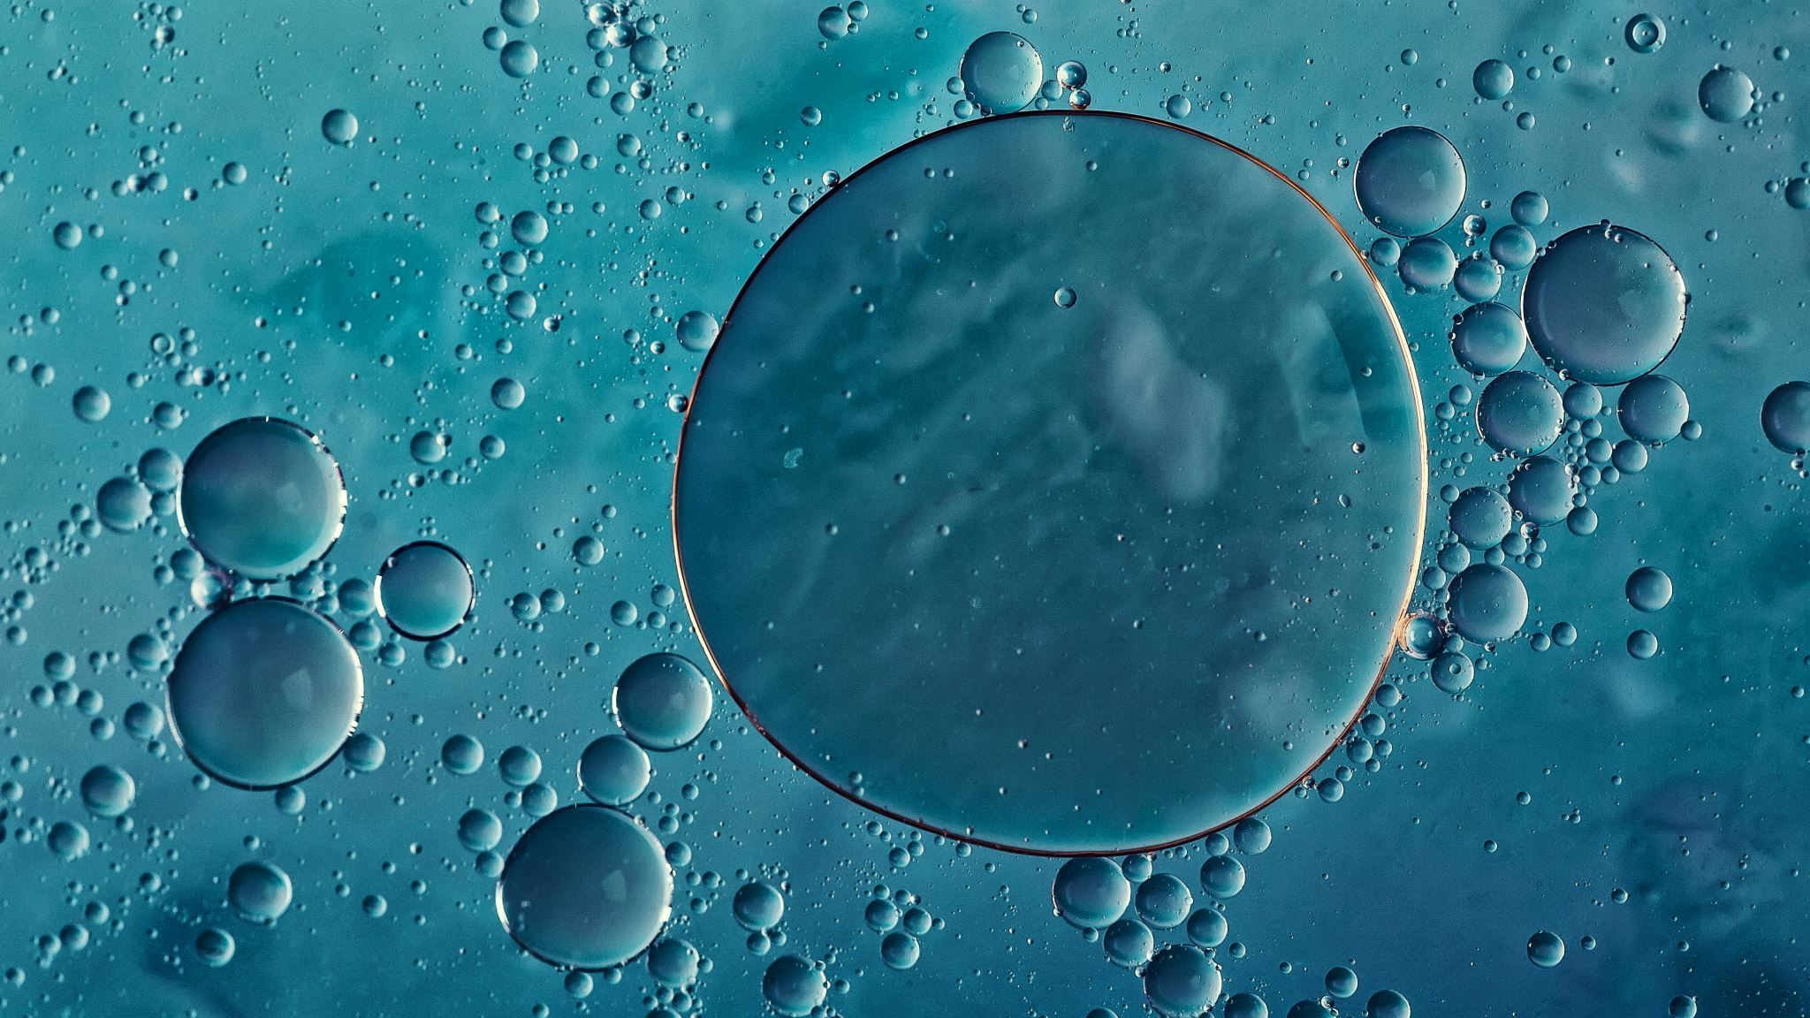
Demonstration time

